Slide 1

LAB EXPERIENCE 6G Connected Autonomous Vehicles

Slide 2
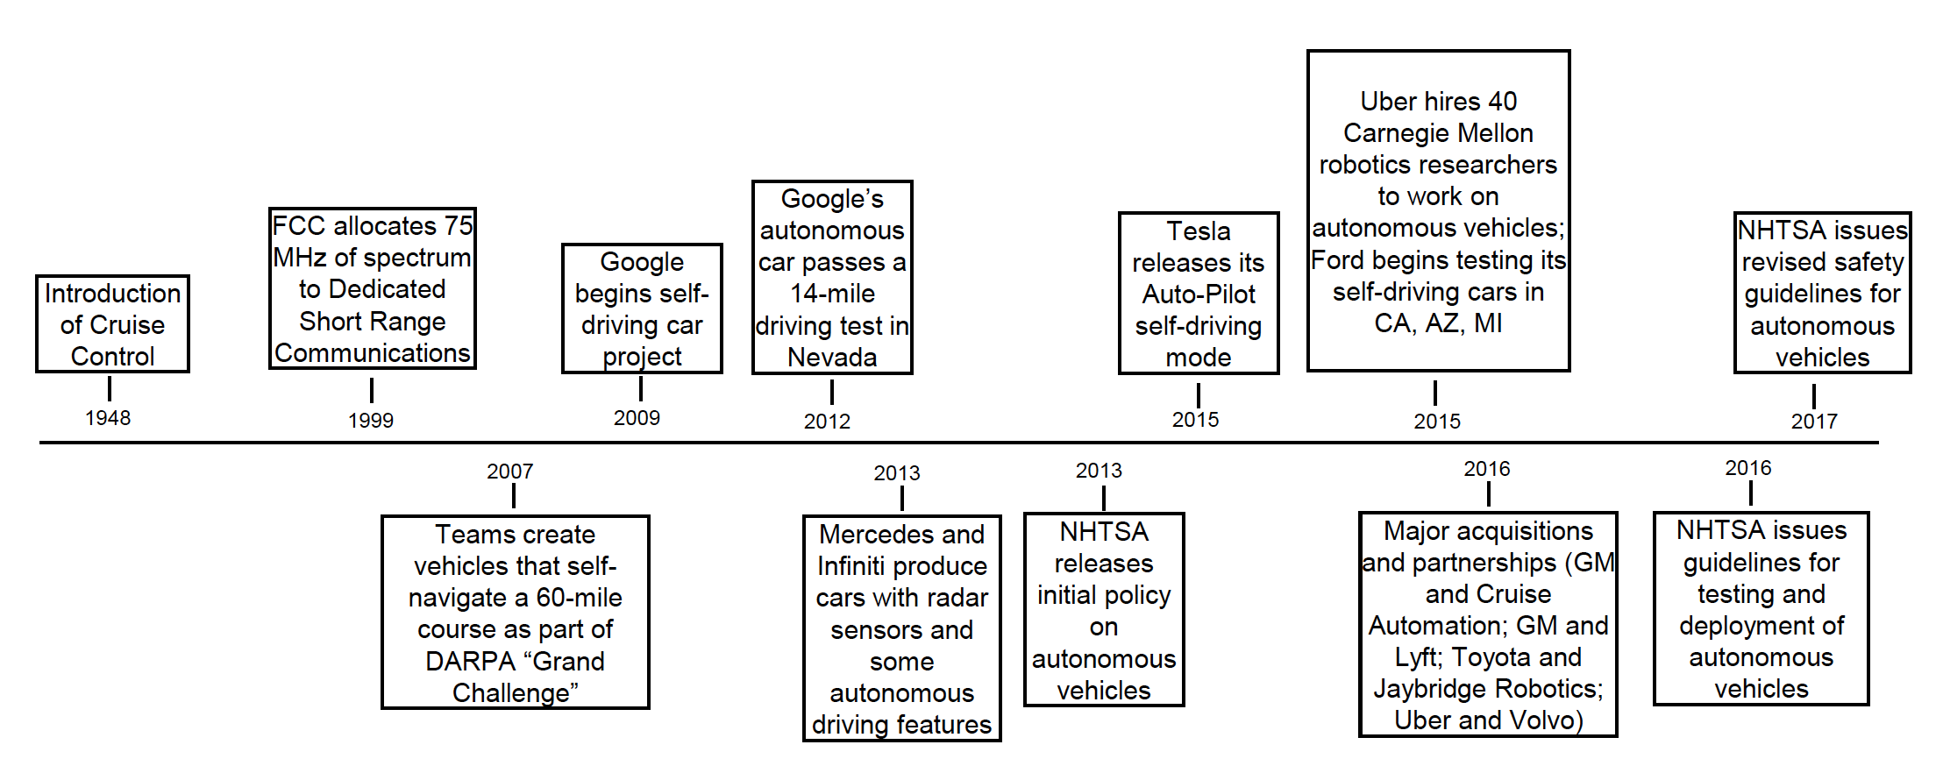
Hystory of Autonomous Vehicles

Slide 3
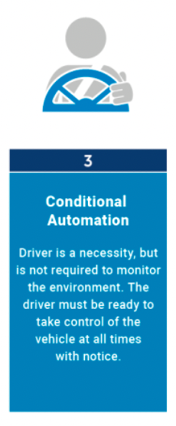
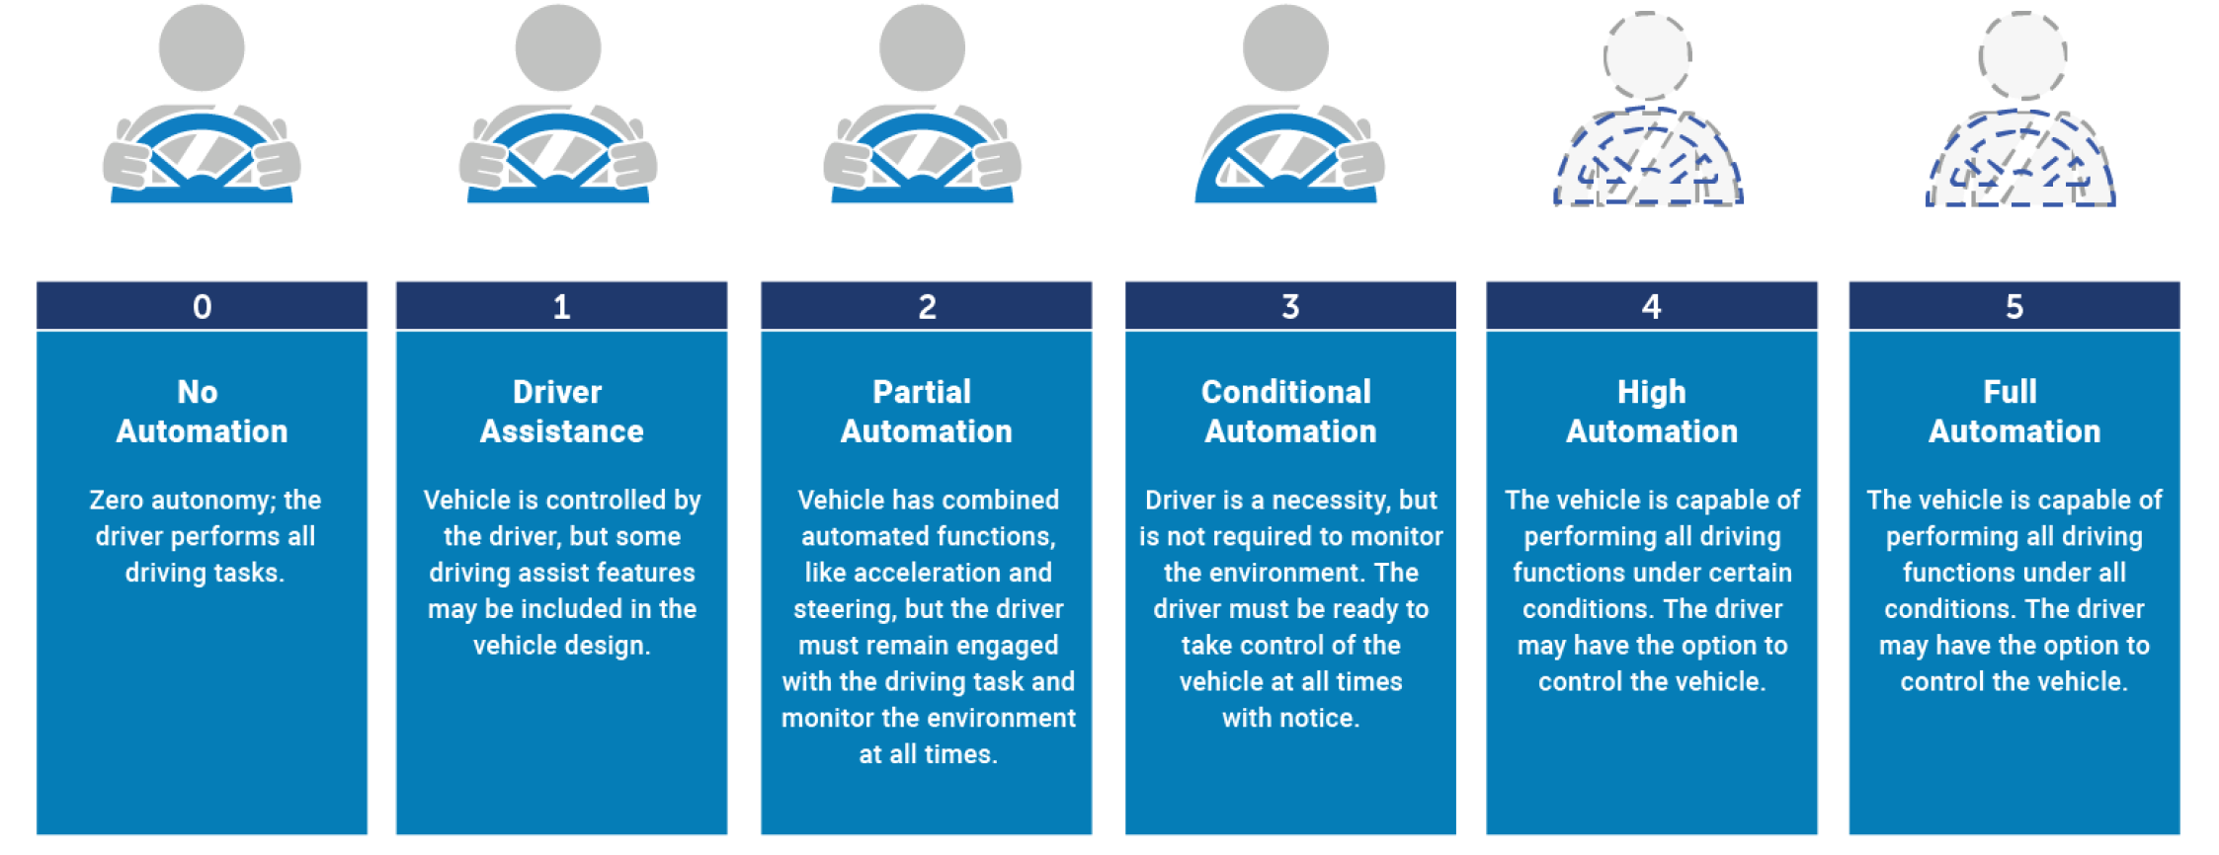
SAE Levels of Automation

Slide 4
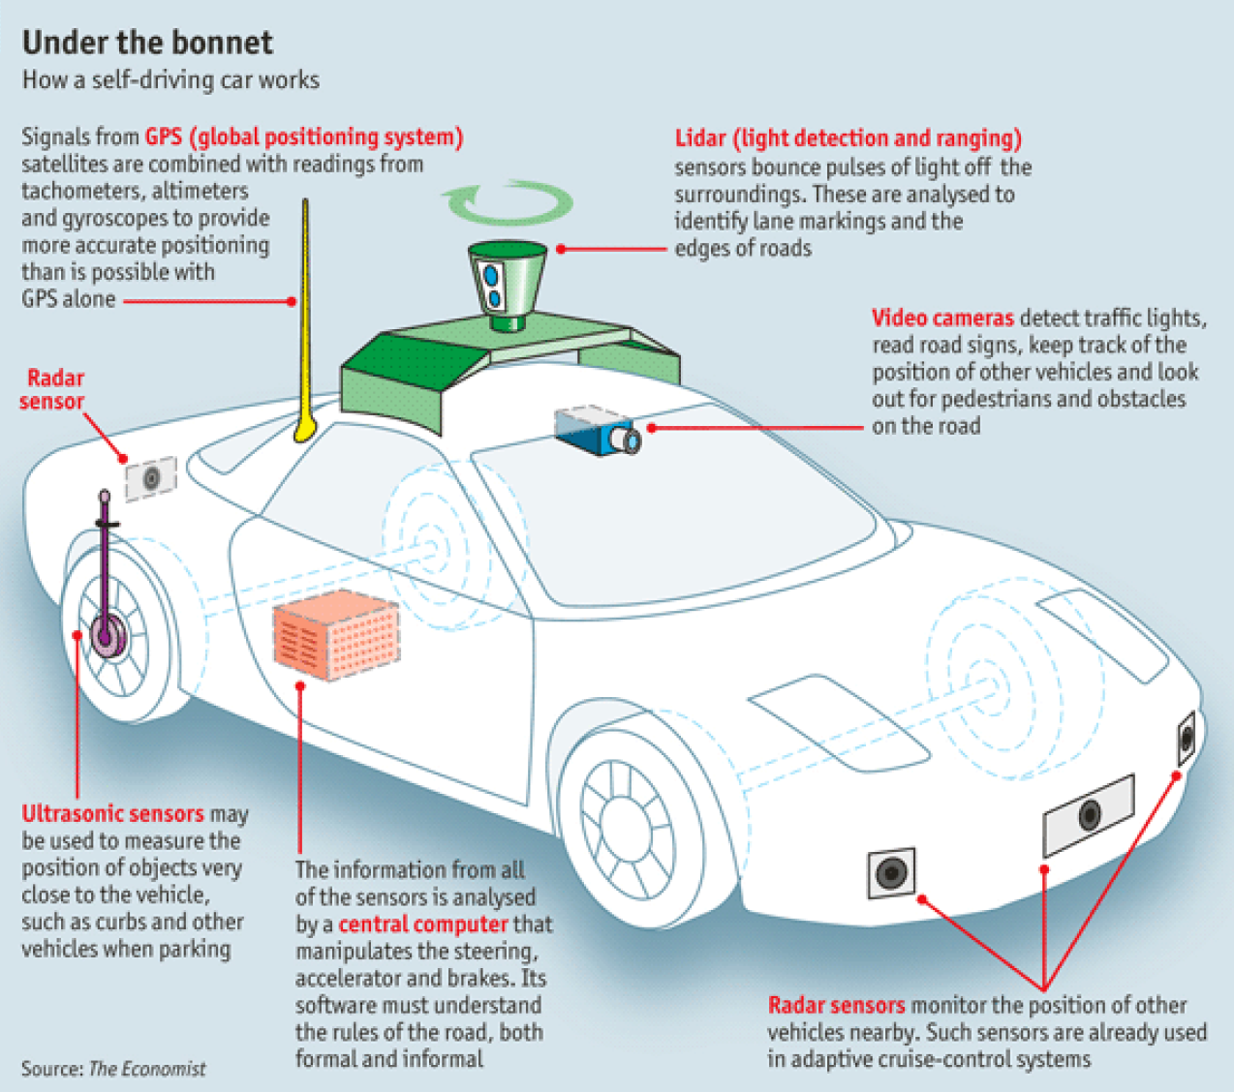
Basic Physical Ecosystem
Vehicle sensing capabilities:
Global Positioning System (GPS)
Radio Detection and Ranging (RADAR)
Light Detection and Ranging (LIDAR)
Camera – Video-based detection
Ultrasonic sensors
Central processing unit (Computer)
Communication interface

Slide 5
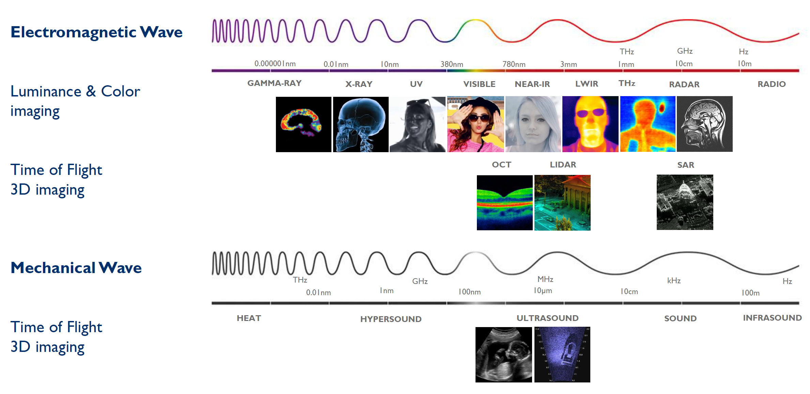
What is Imaging?
Ability to “perceive” the environment at a distance using propagating waves

Slide 6
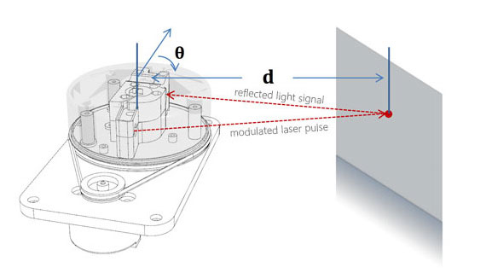
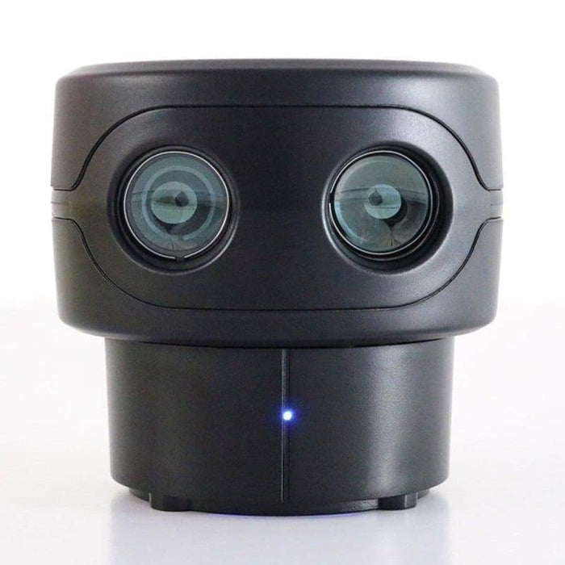
LIDAR working principles

Slide 7
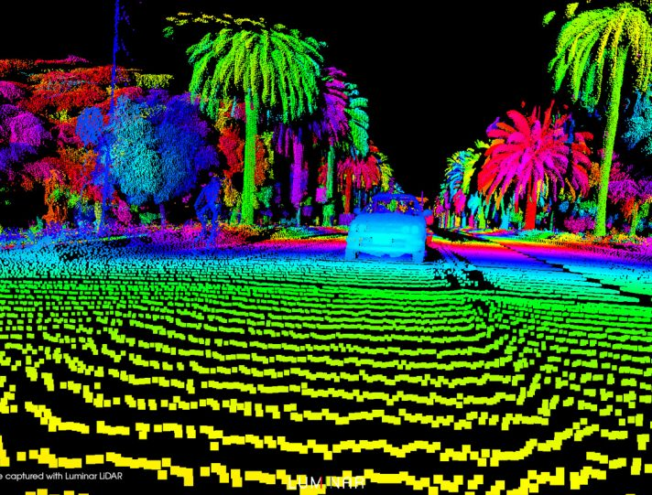
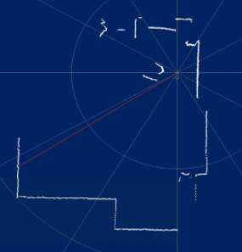
Typical scan using Lidar
3D LIDAR
2D LIDAR

Slide 8
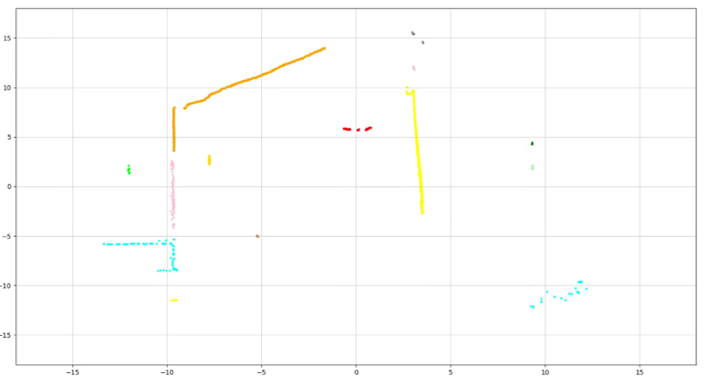
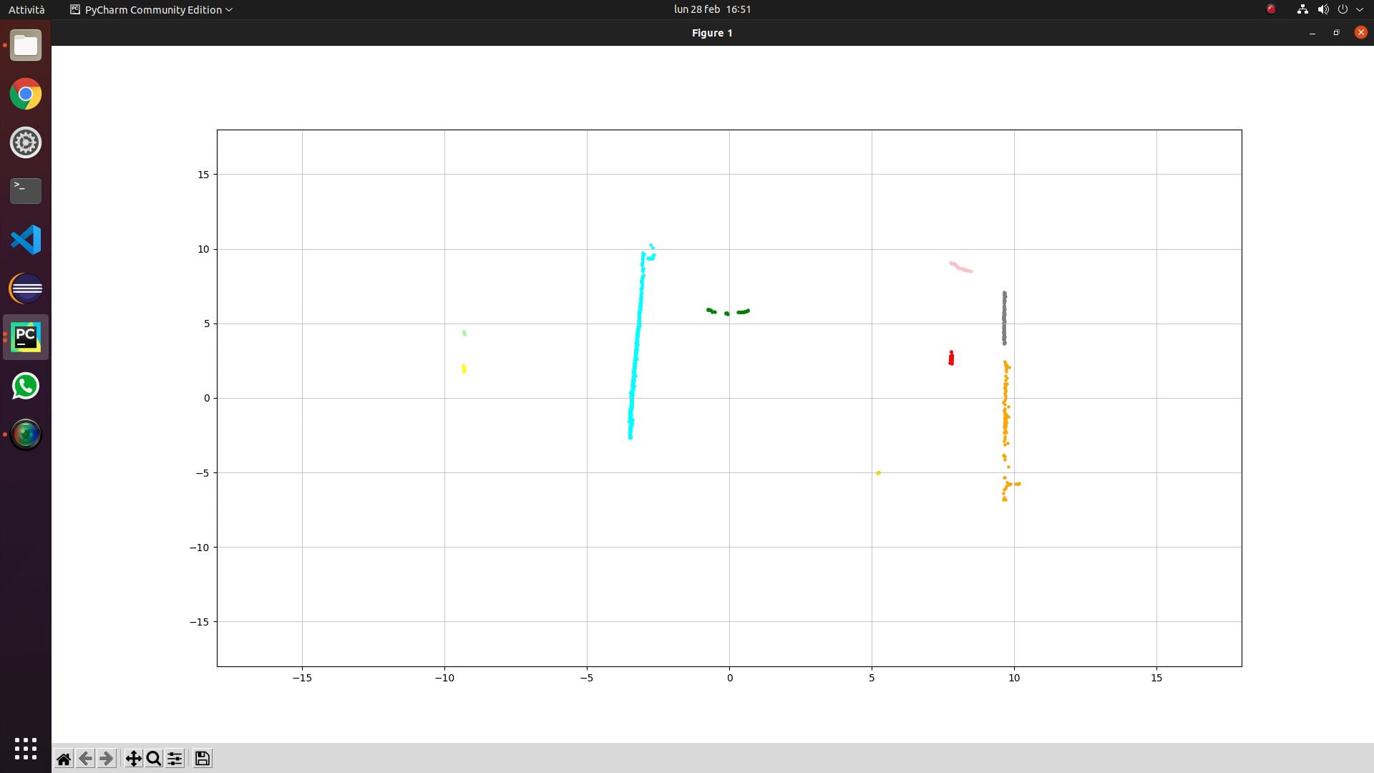
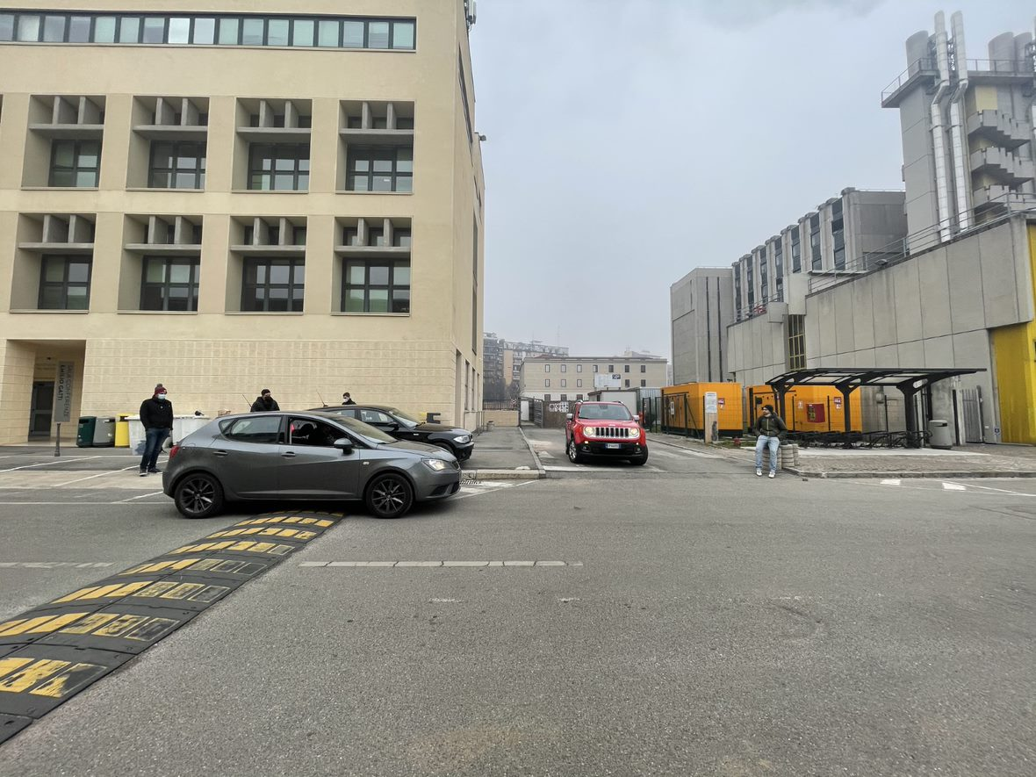
Proposed problem

Slide 9
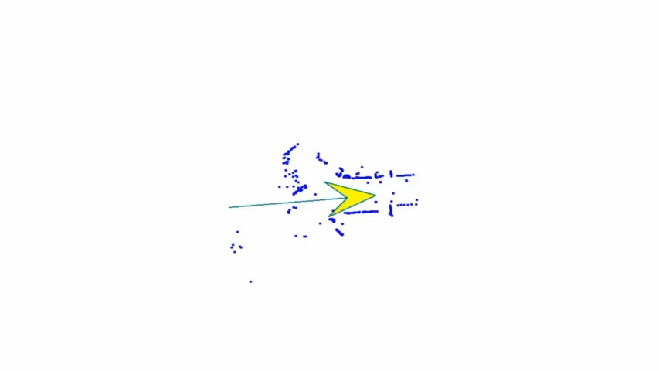
Possible outcome
References
[1] Ren, R.; Fu, H.; Wu, M. “Large-Scale Outdoor SLAM Based on 2D Lidar”. Electronics 2019, 8, 613. https://doi.org/10.3390/electronics8060613
[2] Wang DZ, Posner I, Newman P. “Model-free detection and tracking of dynamic objects with 2D lidar,” The International Journal of Robotics Research. 2015;34(7):1039-1063. doi:10.1177/0278364914562237
[3] A. N. Catapang and M. Ramos, "Obstacle detection using a 2D LIDAR system for an Autonomous Vehicle," 2016 6th IEEE International Conference on Control System, Computing and Engineering (ICCSCE), 2016, pp. 441-445

